Slide 1
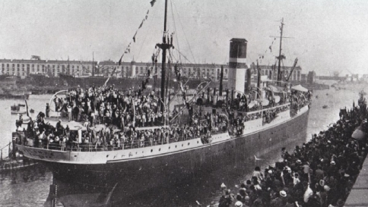
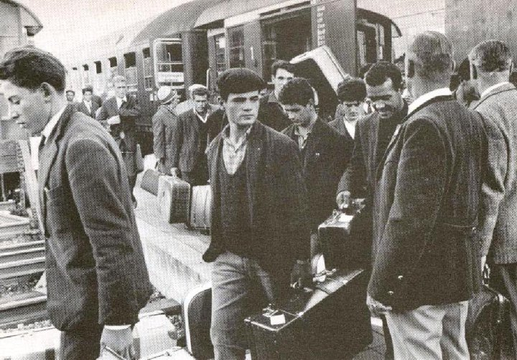
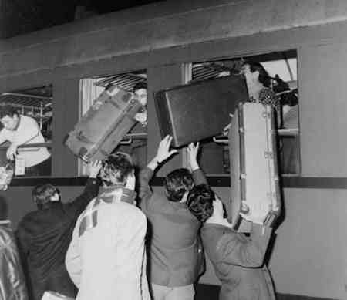
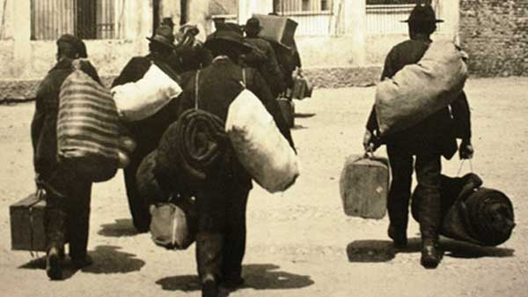
Italian migration
Notes:
Maps courtesy of www.theodora.com/maps, used with permission.
1

Slide 2
Why did people decide to leave Italy ?
For a long time Italy was not united, but instead was made up of individual city-states.
In the early 1800s Italy the process of unification began, joining together to make one great nation.
Even once unification was complete, there was a difference between the north and south of Italy.
The north had more money and power, while the south was extremely poor and people were taxed heavily.
Many Southern Italians couldn’t find work and couldn’t feed themselves or their families.

Slide 3
Why did they choose America?
the Land of Opportunity
With America still growing, there were jobs available in the United States that were not available in Italy.
Even though Italians would take the toughest jobs with low pay, it was still more than they could earn in Italy.

Slide 4
What did they expect ?
Italians never expected to stay in America
Italians wanted to go to America, earn money to send home, and then eventually return to Italy to live.
Most Italian immigrants were young men and most left their wives and children back in Italy, believing they would return to live with them once they made enough money.
Italians did not want to work on farms, as that would be more permanent employment. They wanted to be in the cities where they could work labor for short periods of time.

Slide 5
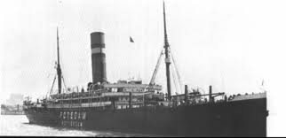
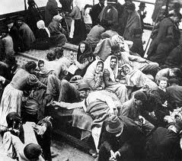
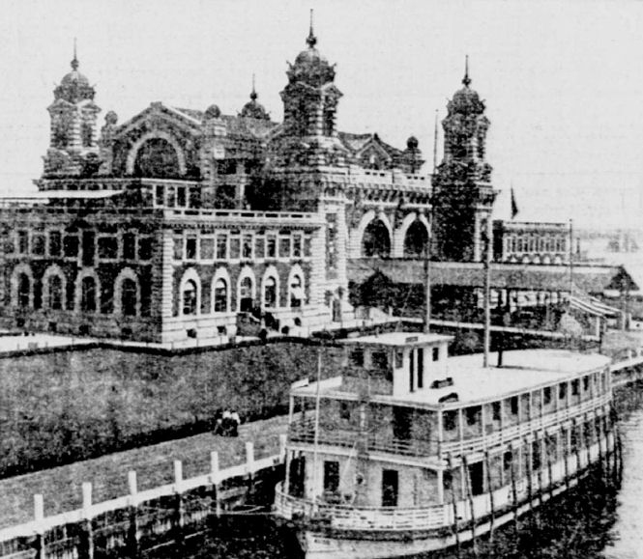
Getting to America
Italians traveled by boat to America
The trip was long and difficult
And when they arrived they still had to get through the Ellis Island inspectors.

Slide 6
When did the Italians start migrating to the United States?
The first Italians went to the United States in 1876 mainly from Southern Italy. Three million people, the largest immigrant group coming into America came from Italy between the years of 1900-1915.
The first Italians traveled in sailing vessels that took up to three months to travel from Italy to the United States. Later, with the invention of the steamship, the trip would only take 10 days.

Slide 7
What America was really like when they arrived.
Because most Italians couldn’t speak English and were unskilled labor, they were given the toughest, most labor-intensive work.
Italians suffered a lot of resistance from Americans and other migrant groups who feared Italians would steal their jobs.
Because Italians couldn’t speak English, and many came from poverty where they didn’t have a formal education, they were looked down on as “dumb” and “stupid.”
Laws were passed to try to stop Italians from migrating to the United States.

